Slide 2
Python Statements
The Python Conceptual Hierarchy
Programs are composed of modules.
2. Modules contain statements.
3. Statements contain expressions.
4. Expressions create and process objects.

Slide 3
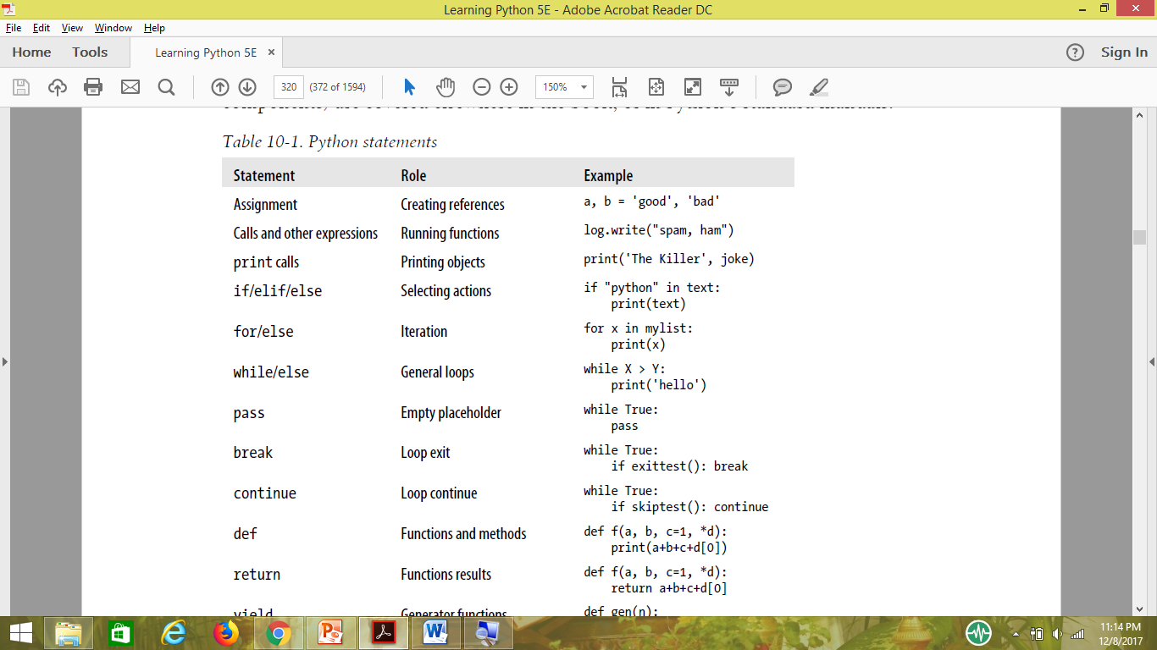

Slide 4
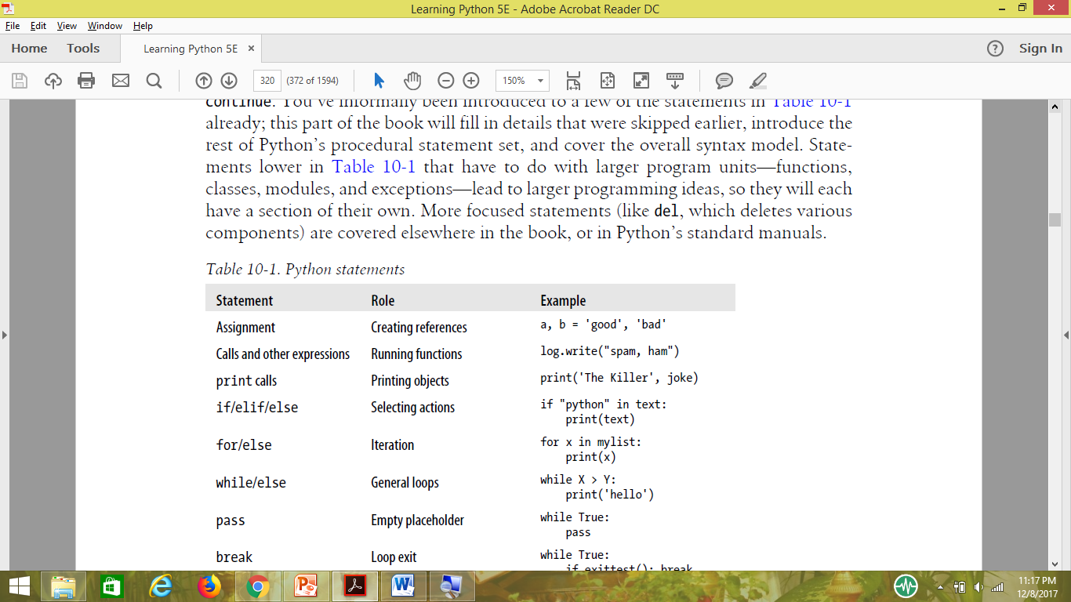
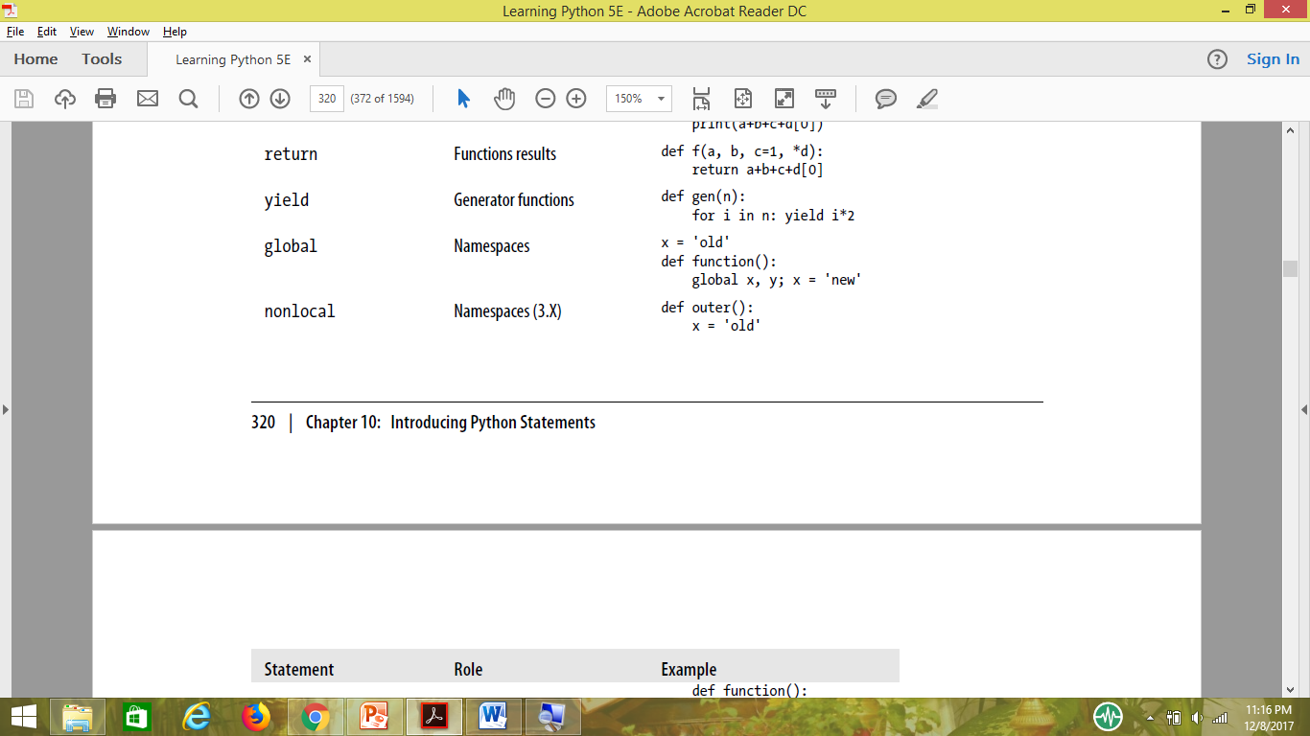

Slide 5
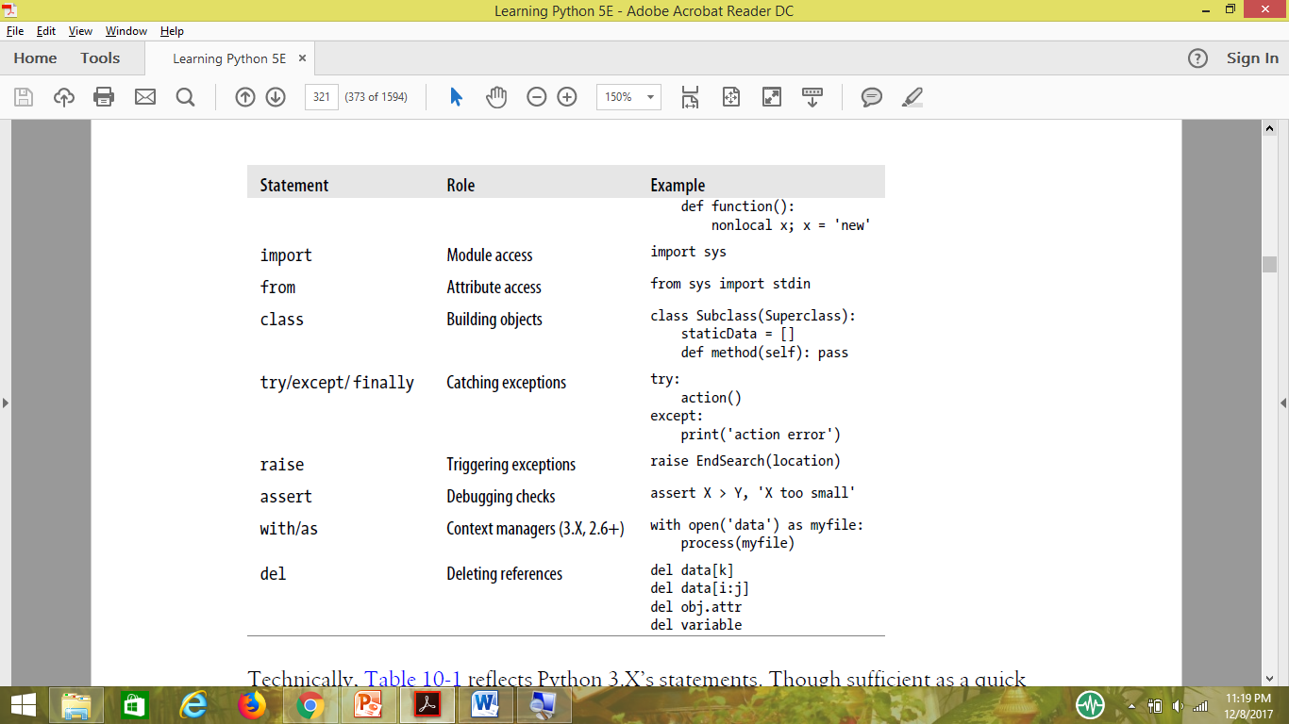

Slide 6
Assignment statements come in a variety of syntax flavors,
print is technically neither a reserved word nor a statement in 3.X, but a built-in function call; because it will nearly always be run as an expression statement, though (and often on a line by itself), it’s generally thought of as a statement type.
yield is also an expression instead of a statement as of 2.5; like print, it’s typically used as an expression statement and so is included in this table, but scripts occasionally assign or otherwise use its result, As an expression, yield is also a reserved word, unlike print.

Slide 7
What Python Removes
Parentheses are optional
End-of-line is end of statement
End of indentation is end of block
Why Indentation Syntax?
Python almost forces programmers to produce uniform, regular, and readable code

Slide 8
Some special rules
Statement rule special cases
Although statements normally appear one per line, it is possible to squeeze more than one statement onto a single line in Python by separating them with semicolons:
a = 1; b = 2; print(a + b) # Three statements on one line

Slide 9
The other special rule for statements is essentially the inverse: you can make a single statement span across multiple lines. To make this work, you simply have to enclose part of your statement in a bracketed pair—parentheses (()), square brackets ([]), or curly braces ({}).
Any code enclosed in these constructs can cross multiple lines: your statement doesn’t end until Python reaches the line containing the closing part of the pair. For instance, to continue a list literal:
mylist = [1111,
2222,
3333]

Slide 10
X = (A + B +
C + D)
if (A == 1 and
B == 2 and
C == 3):
print('spam' * 3)
An older rule also allows for continuation lines when the prior line ends in a backslash:
X = A + B + \
C + D # An error-prone older alternative

Slide 11
Block rule special case
As one special case here, the body of
compound statement can instead appear on the same line as the header in Python, after the colon:
if x > y: print(x)
This allows us to code single-line if statements, single-line while and for loops, and so on.

Slide 12
Example:-interactive loop
while True:
reply = input('Enter text:')
if reply == 'stop': break
print(reply.upper())
Output
Enter text:spam
SPAM
Enter text:42
42
Enter text:stop

Slide 13
Doing Math on User Inputs
>>> reply = '20'
>>> reply ** 2
...error text omitted...
TypeError: unsupported operand type(s) for ** or pow(): 'str' and 'int‘
>>> int(reply) ** 2
400
The above

Slide 14
The above example can be written as
while True:
reply = input('Enter text:')
if reply == 'stop': break
print(int(reply) ** 2)
print('Bye')
Output
Enter text:2
4
Enter text:40
1600
Enter text:stop
Bye

Slide 15
Handling Errors by Testing Inputs
The above example can be written as
while True:
reply = input('Enter text:')
if reply == 'stop':
break
elif not reply.isdigit():
print('Bad!' * 8)
else:
print(int(reply) ** 2)
print('Bye')
Output
Enter text:5
25
Enter text:xyz
Bad!Bad!Bad!Bad!Bad!Bad!Bad!Bad!
Enter text:10
100
Enter text:stop

Slide 16
Handling Errors with try Statements
The above example can be written as
while True:
reply = input('Enter text:')
if reply == 'stop': break
try:
num = int(reply)
except:
print('Bad!' * 8)
else:
print(num ** 2)
print('Bye')

Slide 17
Supporting floating-point numbers
while True:
reply = input('Enter text:')
if reply == 'stop': break
try:
print(float(reply) ** 2)
except:
print('Bad!' * 8)
print('Bye')
Output
Enter text:50
2500.0
Enter text:40.5
1640.25
Enter text:1.23E-100
1.5129e-200
Enter text:spam
Bad!Bad!Bad!Bad!Bad!Bad!Bad!Bad!
Enter text:stop
Bye

Slide 18
Nesting Code Three Levels Deep
while True:
reply = input('Enter text:')
if reply == 'stop':
break
elif not reply.isdigit():
print('Bad!' * 8)
else:
num = int(reply)
if num < 20:
print('low')
else:
print(num ** 2)
print('Bye')
Output
Enter text:19
low
Enter text:20
400
Enter text:spam
Bad!Bad!Bad!Bad!Bad!Bad!Bad!Bad!
Enter text:stop
Bye

Slide 19
Assignments, Expressions, and Prints

Slide 20
Assignment Statements
Assignments create object references
Names are created when first assigned.
Names must be assigned before being referenced
Some operations perform assignments implicitly for loop variables, and function arguments are all implicit assignments.

Slide 21
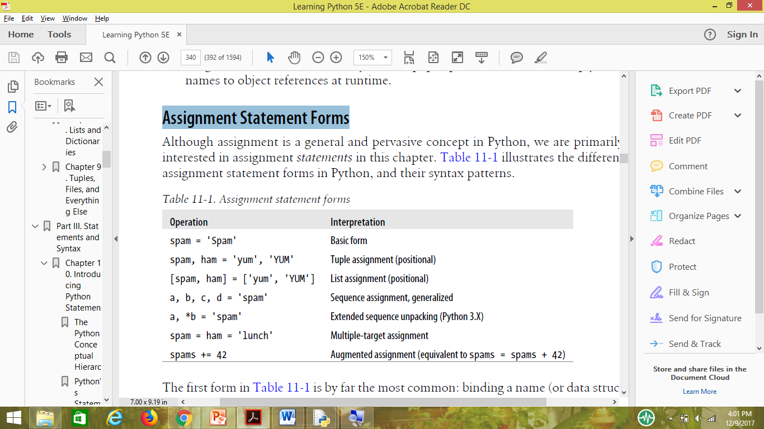
Assignment Statement Forms

Slide 22
The first form in Table 11-1 is by far the most common: binding a name (or data structure component) to a single object. In fact, you could get all your work done with this basic form alone. The other table entries represent special forms that are all optional, but that programmers often find convenient in practice:
Tuple- and list-unpacking assignments
The second and third forms in the table are related. When you code a tuple or list on the left side of the =, Python pairs objects on the right side with targets on the left by position and assigns them from left to right. For example, in the second line of Table 11-1, the name spam is assigned the string 'yum', and the name ham is bound to the string 'YUM'. In this case Python internally may make a tuple of the items on the right, which is why this is called tuple-unpacking assignment.

Slide 23
Sequence assignments
In later versions of Python, tuple and list assignments were generalized into instances of what we now call sequence assignment—any sequence of names can be assigned to any sequence of values, and Python assigns the items one at a time by position. We can even mix and match the types of the sequences involved. The fourth line in Table 11-1, for example, pairs a tuple of names with a string of characters: a is assigned 's', b is assigned 'p', and so on.
Extended sequence unpacking
In Python 3.X (only), a new form of sequence assignment allows us to be more flexible in how we select portions of a sequence to assign. The fifth line in Table 11-1, for example, matches a with the first character in the string on the right and b with the rest: a is assigned 's', and b is assigned 'pam'. This provides a simpler alternative to assigning the results of manual slicing operations.

Slide 24
Multiple-target assignments
The sixth line in Table 11-1 shows the multiple-target form of assignment. In this form, Python assigns a reference to the same object (the object farthest to the right) to all the targets on the left. In the table, the names spam and ham are both assigned references to the same string object, 'lunch'. The effect is the same as if we had coded ham = 'lunch' followed by spam = ham, as ham evaluates to the original string object (i.e., not a separate copy of that object).
Augmented assignments
The last line in Table 11-1 is an example of augmented assignment—a shorthand that combines an expression and an assignment in a concise way. Saying spam += 42, for example, has the same effect as spam = spam + 42, but the augmented form requires less typing and is generally quicker to run. In addition, if the subject is mutable and supports the operation, an augmented assignment may run even
quicker by choosing an in-place update operation instead of an object copy. There is one augmented assignment statement for every binary expression operator in Python.

Slide 25
Sequence Assignments
% python
>>> nudge = 1 # Basic assignment
>>> wink = 2
>>> A, B = nudge, wink # Tuple assignment
>>> A, B # Like A = nudge; B = wink
(1, 2)
>>> [C, D] = [nudge, wink] # List assignment
>>> C, D
(1, 2)

Slide 26
Because Python creates a temporary tuple that saves the original values of the variables on the right while the statement runs, unpacking assignments are also a way to swap two variables’ values without creating
a temporary variable of your own—the tuple on the
right remembers the prior values of the variables
automatically:
>>> nudge = 1
>>> wink = 2
>>> nudge, wink = wink, nudge # Tuples: swaps values
>>> nudge, wink # Like T = nudge; nudge = wink; wink = T
(2, 1)

Slide 27
In fact, the original tuple and list assignment forms in Python have been generalized to accept any type of sequence (really, iterable) on the right as long as it is of the same length as the sequence on the left. You can assign a tuple of values to a list of variables, a string of characters to a tuple of variables, and so on. In all cases, Python assigns items in the sequence on the right to variables in the sequence on the left b position, from left to right:
>>> [a, b, c] = (1, 2, 3) # Assign tuple of values to list of names
>>> a, c
(1, 3)
>>> (a, b, c) = "ABC" # Assign string of characters to tuple
>>> a, c
('A', 'C')

Slide 28
Advanced sequence assignment patterns
Although we can mix and match sequence types around the = symbol, we must generally have the same number of items on the right as we have variables on the left, or we’ll get an error. Python 3.X allows us to be more general with extended unpacking * syntax, described in the next section. But normally in 3.X—and always in 2.X—the number of
items in the assignment target and subject must match:
>>> string = 'SPAM'
>>> a, b, c, d = string # Same number on both sides
>>> a, d
('S', 'M')
>>> a, b, c = string # Error if not
...error text omitted...
ValueError: too many values to unpack (expected 3)

Slide 29
To be more flexible, we can slice in both 2.X and 3.X. There are a variety of ways to employ slicing to make this last case work:
>>> a, b, c = string[0], string[1], string[2:] # Index and slice
>>> a, b, c
('S', 'P', 'AM')
>>> a, b, c = list(string[:2]) + [string[2:]] # Slice and concatenate
>>> a, b, c
('S', 'P', 'AM')
>>> a, b = string[:2] # Same, but simpler
>>> c = string[2:]
>>> a, b, c
('S', 'P', 'AM')
>>> (a, b), c = string[:2], string[2:] # Nested sequences
>>> a, b, c
('S', 'P', 'AM')

Slide 30
As the last example in this interaction demonstrates, we can even assign nested sequences, and Python unpacks their parts according to their shape, as expected. In this case, we are assigning a tuple of two items, where the first item is a nested sequence (a string), exactly as though we had coded it this way:
>>> ((a, b), c) = ('SP', 'AM') # Paired by shape and position
>>> a, b, c
('S', 'P', 'AM')
Python pairs the first string on the right ('SP') with the first tuple on the left ((a, b)) and assigns one character at a time, before assigning the entire second string ('AM') to the variable c all at once.

Slide 31
for (a, b, c) in [(1, 2, 3), (4, 5, 6)]: ... # Simple tuple assignment
for ((a, b), c) in [((1, 2), 3), ((4, 5), 6)]: ... # Nested tuple assignment
Sequence-unpacking assignments also give rise to another common coding idiom in Python—assigning an integer series to a set of variables:
>>> red, green, blue = range(3)
>>> red, blue
(0, 2)
This initializes the three names to the integer codes 0, 1, and 2, respectively (it’s Python’s equivalent of the enumerated data types
To make sense of this, you need to know that the range built-in function generates a list of successive integers (in 3.X only, it requires a list around it if you wish to display its values all at once like this):
>>> list(range(3)) # list() required in Python 3.X only
[0, 1, 2]

Slide 32
Another place you may see a tuple assignment at work is for splitting a sequence into its front and the rest in loops like this:
>>> L = [1, 2, 3, 4]
>>> while L:
... front, L = L[0], L[1:] # See next section for 3.X * alternative
... print(front, L)
...
1 [2, 3, 4]
2 [3, 4]
3 [4]
4 []
The tuple assignment in the loop here could be coded as the following two lines instead, but it’s often more convenient to string them together:
... front = L[0]
... L = L[1:]
Can also be achieved with the append and pop methods of list objects;

Slide 33
Extended Sequence Unpacking in Python 3.X
>>> seq = [1, 2, 3, 4]
>>> a, b, c, d = seq
>>> print(a, b, c, d)
1 2 3 4
>>> a, b = seq
ValueError: too many values to unpack (expected 2)
In Python 3.X, though, we can use a single starred name in the target to match moregenerally. In the following continuation of our interactive session, a matches the first item in the sequence, and b matches the rest:
>>> a, *b, c = seq
>>> a
1
>>> b
[2, 3]
>>> c
4
>>> a, b, *c = seq
>>> a
1
>>> b
[2]
>>> c
3,4
>>> a, *b = seq
>>> a
1
>>> b
[2, 3, 4]
or
or

Slide 34
Unpacking characters in a string and a range (an iterable in 3.X):
>>> a, *b = 'spam'
>>> a, b
('s', ['p', 'a', 'm'])
>>> a, *b, c = 'spam'
>>> a, b, c
('s', ['p', 'a'], 'm')
>>> a, *b, c = range(4)
>>> a, b, c
(0, [1, 2], 3)

Slide 35
With slices
>>> S = 'spam'
>>> S[0], S[1:] # Slices are type-specific, * assignment always returns a list
('s', 'pam')
>>> S[0], S[1:3], S[3]
('s', 'pa', 'm')
Given this extension in 3.X, as long as we’re processing a list the last example of the prior section becomes even simpler, since we don’t have to manually slice to get the first and rest of the items:
>>> L = [1, 2, 3, 4]
>>> while L:
... front, *L = L # Get first, rest without slicing
... print(front, L)
...
1 [2, 3, 4]
2 [3, 4]
3 [4]
4 []

Slide 36
Boundary cases
>>> seq = [1, 2, 3, 4]
>>> a, b, c, *d = seq
>>> print(a, b, c, d)
1 2 3 [4]
If nothing left to match
>>> a, b, c, d, *e = seq
>>> print(a, b, c, d, e)
1 2 3 4 []
>>> a, b, *e, c, d = seq
>>> print(a, b, c, d, e)
1 2 3 4 []

Slide 37
Finally, errors can still be triggered if there is more than one starred name, if there are too few values and no star (as before), and if the starred name is not itself coded inside a sequence:
>>> a, *b, c, *d = seq
SyntaxError: two starred expressions in assignment
>>> a, b = seq
ValueError: too many values to unpack (expected 2)
>>> *a = seq
SyntaxError: starred assignment target must be in a list or tuple
>>> *a, = seq
>>> a
[1, 2, 3, 4]

Slide 38
A useful convenience
extended sequence unpacking assignment is just a convenience. We can usually achieve the same effects with explicit indexing and slicing (and in fact must in Python 2.X), but extended unpacking is simpler to code. The common “first, rest” splitting coding pattern, for example, can be coded either way, but slicing involves extra work:
>>> seq
[1, 2, 3, 4]
>>> a, *b = seq # First, rest
>>> a, b
(1, [2, 3, 4])
>>> a, b = seq[0], seq[1:] # First, rest: traditional
>>> a, b
(1, [2, 3, 4])

Slide 39
>>> *a, b = seq # Rest, last
>>> a, b
([1, 2, 3], 4)
>>> a, b = seq[:-1], seq[-1] # Rest, last: traditional
>>> a, b
([1, 2, 3], 4)

Slide 40
Application to for loops
for (a, *b, c) in [(1, 2, 3, 4), (5, 6, 7, 8)]:
...
When used in this context, on each iteration Python simply assigns the next tuple of values to the tuple of names. On the first loop, for example, it’s as if we’d run the following assignment statement:
a, *b, c = (1, 2, 3, 4) # b gets [2, 3]
The names a, b, and c can be used within the loop’s code to reference the extracted components. In fact, this is really not a special case at all, but just an instance of general assignment at work. As we saw earlier in this chapter, we can do the same thing with simple tuple assignment in both Python 2.X and 3.X:
for (a, b, c) in [(1, 2, 3), (4, 5, 6)]: # a, b, c = (1, 2, 3), ...
And we can always emulate 3.X’s extended assignment behavior in 2.X by manually slicing:
for all in [(1, 2, 3, 4), (5, 6, 7, 8)]:
a, b, c = all[0], all[1:3], all[3]

Slide 41
Multiple-Target Assignments
A multiple-target assignment simply assigns all the given names to the object all the way to the right. The following, for example, assigns the three variables a, b, and c to the string 'spam':
>>> a = b = c = 'spam'
>>> a, b, c
('spam', 'spam', 'spam')
This form is equivalent to (but easier to code than) these three assignments:
>>> c = 'spam'
>>> b = c
>>> a = b

Slide 42
Multiple-target assignment and shared references
>>> a = b = 0
>>> b = b + 1
>>> a, b
(0, 1)
Here, changing b only changes b because numbers do not support in-place changes. But for lists we have
`>>> a = b = []
>>> b.append(42)
>>> a, b
([42], [42])

Slide 43
But if we want two separate lists object by running a distinct literal expression:
>>> a = []
>>> b = [] # a and b do not share the same object
>>> b.append(42)
>>> a, b
([], [42])
A tuple assignment like the following has the same effect—by running two list expressions, it creates two distinct objects:
>>> a, b = [], [] # a and b do not share the same object

Slide 44
Augmented Assignments
Known as augmented assignments, and borrowed from the C language, these formats are mostly just shorthand.
X = X + Y # Traditional form
X += Y # Newer augmented form
Table 11-2. Augmented assignment statements
X += Y X &= Y X −= Y X |= Y
X *= Y X ^= Y X /= Y X >>= Y
X %= Y X <<= Y X **= Y X //= Y

Slide 45
Augmented assignment works on any type that supports the implied binary expression. For example, here are two ways to add 1 to a name:
>>> x = 1
>>> x = x + 1 # Traditional
>>> x
2
>>> x += 1 # Augmented
>>> x
3
When applied to a sequence such as a string, the augmented form performs concatenation
instead. Thus, the second line here is equivalent to typing the longer S = S +
"SPAM":
>>> S = "spam"
>>> S += "SPAM" # Implied concatenation
>>> S
'spamSPAM'

Slide 46
Augmented assignments advantages
There’s less for you to type.
The left side has to be evaluated only once.(As x appears only once in x += y ). So fast in execution
The optimal technique is automatically chosen. That is, for objects that support in-place changes, the augmented forms automatically perform in-place change operations instead of slower copies.

Slide 47
augmented assignments for mutable objects
>>> L = [1, 2]
>>> L = L + [3] # Concatenate: slower
>>> L
[1, 2, 3]
>>> L.append(4) # Faster, but in place
>>> L
[1, 2, 3, 4]
And to add a set of items to the end, we can either concatenate again or call the list method:2
>>> L = L + [5, 6] # Concatenate: slower
>>> L
[1, 2, 3, 4, 5, 6]
>>> L.extend([7, 8]) # Faster, but in place
>>> L
[1, 2, 3, 4, 5, 6, 7, 8]

Slide 48
When we use augmented assignment to extend a list, we can largely forget these details
—Python automatically calls the quicker extend method instead of using the slower concatenation operation implied by +:
>>> L += [9, 10] # Mapped to L.extend([9, 10])
>>> L
[1, 2, 3, 4, 5, 6, 7, 8, 9, 10]
Note however, that because of this equivalence += for a list is not exactly the same as a + and = in all cases—for lists += allows arbitrary sequences (just like extend), but concatenation normally does not:
>>> L = []
>>> L += 'spam' # += and extend allow any sequence, but + does not!
>>> L
['s', 'p', 'a', 'm']
>>> L = L + 'spam'
TypeError: can only concatenate list (not "str") to list

Slide 49
Augmented assignment and shared references
+= is an inplace change for lists; thus, it is not exactly like + concatenation, which always makes a new object.
>>> L = [1, 2]
>>> M = L # L and M reference the same object
>>> L = L + [3, 4] # Concatenation makes a new object
>>> L, M # Changes L but not M
([1, 2, 3, 4], [1, 2])
>>> L = [1, 2]
>>> M = L
>>> L += [3, 4] # But += really means extend
>>> L, M # M sees the in-place change too!
([1, 2, 3, 4], [1, 2, 3, 4])

Slide 50
Variable Name Rules
Syntax: (underscore or letter) + (any number of letters, digits, or underscores)
Case matters: SPAM is not the same as spam
Reserved words are off-limits. Cannot be used as name.

Slide 51
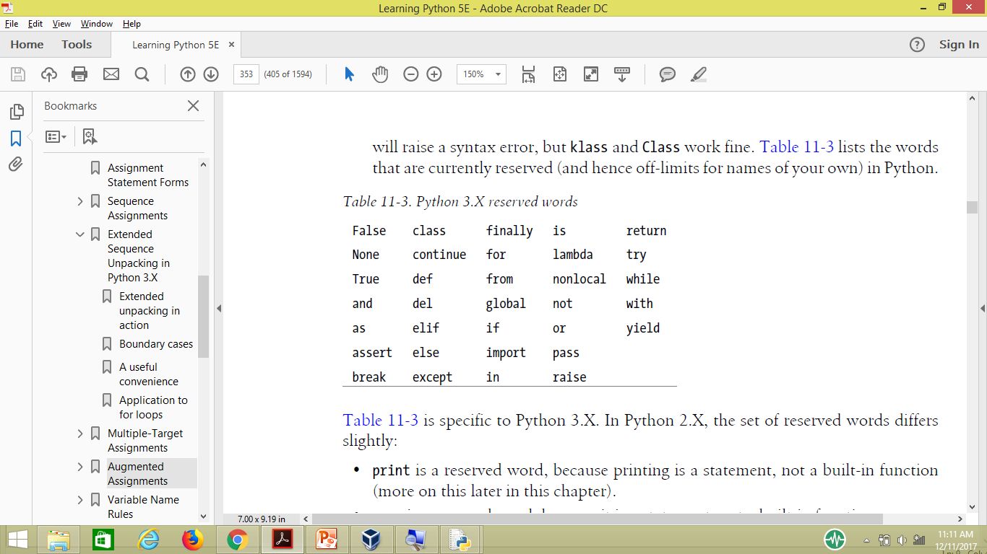

Slide 52
Naming conventions
Names that begin with a single underscore (_X) are not imported by a from module import * statement.
Names that have two leading and trailing underscores (__X__) are system-defined names that have special meaning to the interpreter.
Names that begin with two underscores and do not end with two more (__X) are localized (“mangled”) to enclosing classes.
The name that is just a single underscore (_) retains the result of the last expression when you are working interactively.

Slide 53
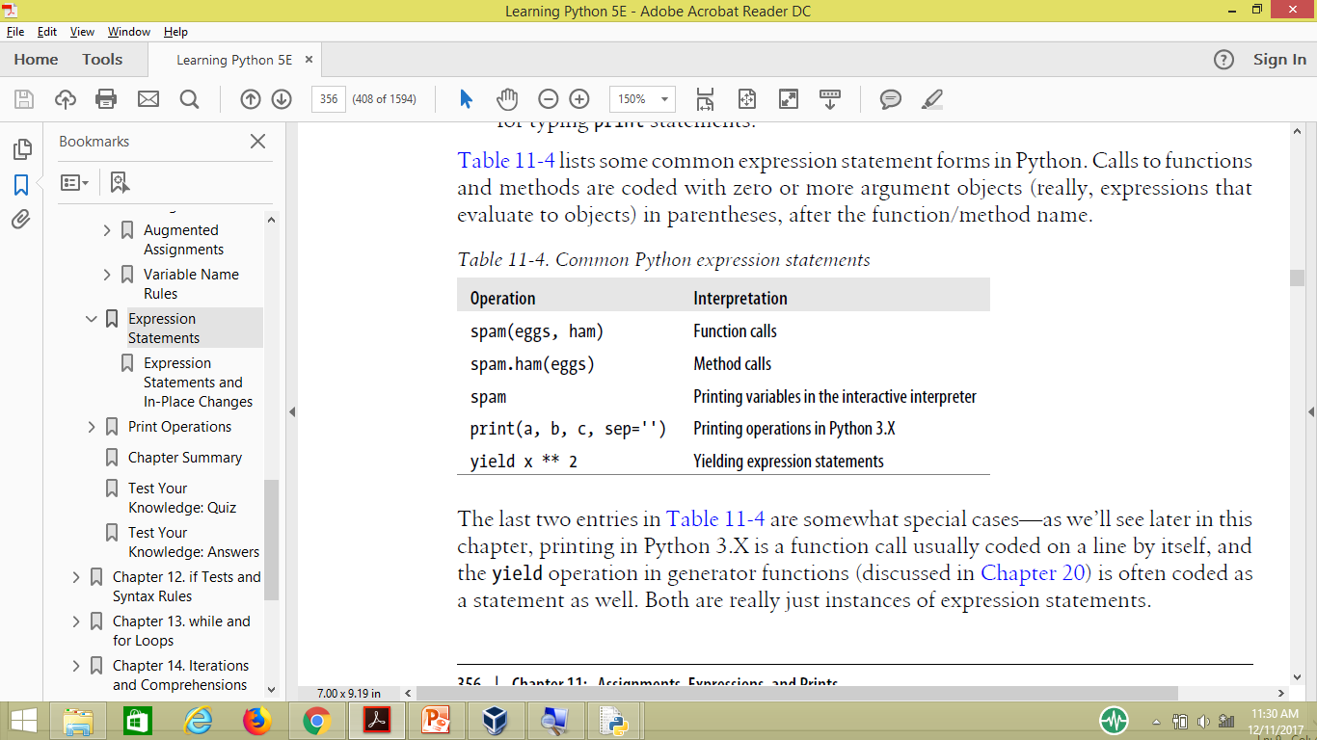
Expression Statements
Expressions are commonly used as statements in two situations:
For calls to functions and methods
For printing values at the interactive prompt.

Slide 54
>>> x = print('spam') # print is a function call expression in 3.X
spam
>>> print(x) # But it is coded as an expression statement None
Yield is a function call in generator functions

Slide 55
Expression Statements and In-Place Changes
Expression statements are often used to run list methods that change a list in place:
>>> L = [1, 2]
>>> L.append(3) # Append is an in-place change
>>> L
[1, 2, 3]
However, it’s not unusual for Python newcomers to code such an operation as an assignment statement instead, intending to assign L to the larger list:
>>> L = L.append(4) # But append returns None, not L
>>> print(L) # So we lose our list!
None
Calling an in-place change operation such as append, sort, or reverse on a list always changes the list in place, but these methods do not return the list they have changed; instead, they return the None object.

Slide 56
Print Operations
Technically, printing converts one or more objects to their textual representations, adds some minor formatting, and sends the resulting text to either standard output or another file-like stream. In a bit more detail, print is strongly bound up with the notions of files and streams in Python:
Printing is also one of the most visible places where Python 3.X and 2.X have diverged.
• In Python 3.X, printing is a built-in function, with keyword arguments for special
modes.
• In Python 2.X, printing is a statement with specific syntax all its own.

Slide 57
File object methods
file object methods are that write text (e.g., file.write(str)). Printing operations are similar, but more focused—whereas file write methods write strings to arbitrary files, print writes objects to the stdout stream by default, with some automatic formatting added. Unlike with file methods,
there is no need to convert objects to strings when using print operations.

Slide 58
Standard output stream
The standard output stream (often known as stdout) is simply a default place to send a program’s text output. Along with the standard input and error streams, it’s one of three data connections created when your script starts.
The standard output stream is usually mapped to the window where you started your Python program, unless it’s been redirected to a file or pipe in your operating system’s shell.
Because the standard output stream is available in Python as the stdout file object in the built-in sys module (i.e., sys.stdout), it’s possible to emulate print with file write method calls.
However, print is noticeably easier to use and makes it easy to print text to other files and streams.

Slide 59
The Python 3.X print Function
Call format
Syntactically, calls to the 3.X print function have the following form (the flush argument is new as of Python 3.3):
print([object, ...][, sep=' '][, end='\n'][, file=sys.stdout][, flush=False])
items in square brackets are optional and may be omitted in a given call, and values after = give argument defaults.

Slide 60
• sep is a string inserted between each object’s text, which defaults to a single space if not passed; passing an empty string suppresses separators altogether.
• end is a string added at the end of the printed text, which defaults to a \n newline character if not passed. Passing an empty string avoids dropping down to the next output line at the end of the printed text—the next print will keep adding to the end of the current output line.
• file specifies the file, standard stream, or other file-like object to which the text will be sent; it defaults to the sys.stdout standard output stream if not passed. Any object with a file-like write(string) method may be passed, but real files should be already opened for output.
flush, added in 3.3, defaults to False. It allows prints to mandate that their text be flushed through the output stream immediately to any waiting recipients. Normally, whether printed output is buffered in memory or not is determined by file; passing a true value to flush forcibly flushes the stream.

Slide 61
The 3.X print function in action
>>> print() # Display a blank line
>>> x = 'spam'
>>> y = 99
>>> z = ['eggs']
>>>
>>> print(x, y, z) # Print three objects per defaults
spam 99 ['eggs‘]

Slide 62
There’s no need to convert objects to strings here, as would be required for file write methods. By default, print calls add a space between the objects printed. To suppress this, send an empty string to the sep keyword argument, or send an alternative separator of your choosing:
>>> print(x, y, z, sep='') # Suppress separator
spam99['eggs']
>>>
>>> print(x, y, z, sep=', ') # Custom separator
spam, 99, ['eggs']
Also by default, print adds an end-of-line character to terminate the output line.

Slide 63
We can suppress end of line and avoid the line break altogether by passing an empty string to the end keyword argument,
>>> print(x, y, z, end='') # Suppress line break
spam 99 ['eggs']>>>
>>>
>>> print(x, y, z, end=''); print(x, y, z) # Two prints, same output line
spam 99 ['eggs']spam 99 ['eggs']
>>> print(x, y, z, end='...\n') # Custom line end
spam 99 ['eggs']...
>>>

Slide 64
You can also combine keyword arguments to specify both separators and end-of-line strings—they may appear in any order but must appear after all the objects being printed:
>>> print(x, y, z, sep='...', end='!\n') # Multiple keywords
spam...99...['eggs']!
>>> print(x, y, z, end='!\n', sep='...') # Order doesn't matter
spam...99...['eggs']!

Slide 65
printing in files and print formatting
>>> print(x, y, z, sep='...', file=open('data.txt', 'w')) # Print to a file
>>> print(x, y, z) # Back to stdout
spam 99 ['eggs']
>>> print(open('data.txt').read()) # Display file text
spam...99...['eggs']
>>> text = '%s: %-.4f, %05d' % ('Result', 3.14159, 42)
>>> print(text)
Result: 3.1416, 00042
>>> print('%s: %-.4f, %05d' % ('Result', 3.14159, 42))
Result: 3.1416, 00042

Slide 66
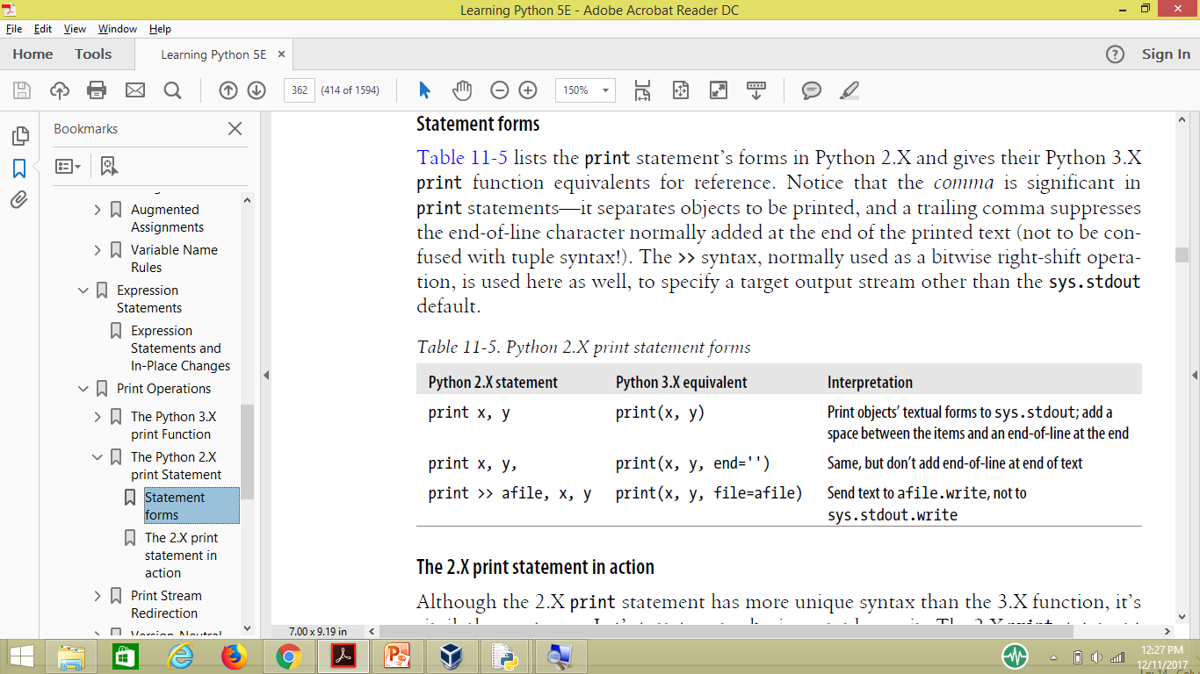
The Python 2.X print Statement

Slide 67
The 2.X print statement in action
>>> x = 'a'
>>> y = 'b'
>>> print x, y
a b
>>> print x, y,; print x, y
a b a b
>>> print x + y
ab
>>> print '%s...%s' % (x, y)
a...b

Slide 68
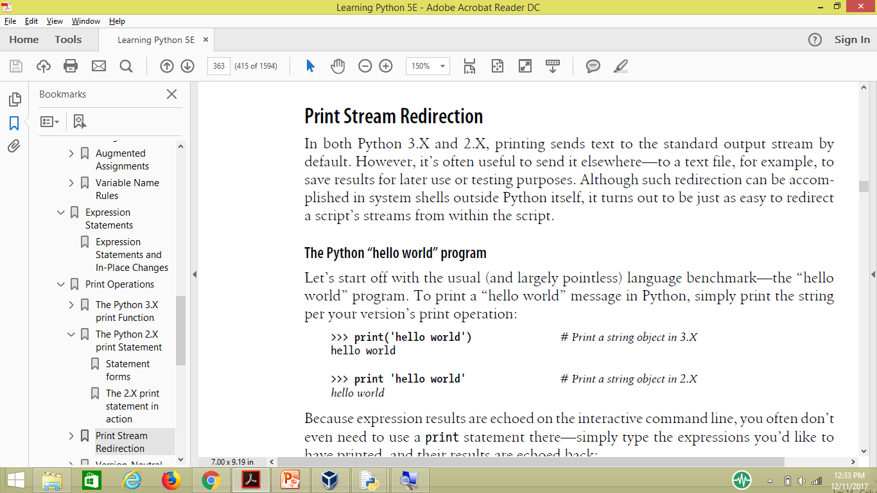
Print Stream Redirection

Slide 69
>>> 'hello world' # Interactive echoes
'hello world
>>> import sys # Printing the hard way
>>> sys.stdout.write('hello world\n')
hello world

Slide 70
Manual stream redirection
print(X, Y) # Or, in 2.X: print X, Y
is equivalent to the longer:
import sys
sys.stdout.write(str(X) + ' ' + str(Y) + '\n')
import sys
sys.stdout = open('log.txt', 'a') # Redirects prints to a file
...
print(x, y, x) # Shows up in log.txt

Slide 71
Automatic stream redirection
>>> import sys
>>> temp = sys.stdout # Save for restoring later
>>> sys.stdout = open('log.txt', 'a') # Redirect prints to a file
>>> print('spam') # Prints go to file, not here
>>> print(1, 2, 3)
>>> sys.stdout.close() # Flush output to disk
>>> sys.stdout = temp # Restore original stream
>>> print('back here') # Prints show up here again
back here
>>> print(open('log.txt').read()) # Result of earlier prints
spam
1 2 3

Slide 72
In 3.X, the file keyword allows a single print call to send its text to the write method of a file (or file-like object), without actually resetting sys.stdout.
log = open('log.txt', 'a') # 3.X
print(x, y, z, file=log) # Print to a file-like object
print(a, b, c) # Print to original stdout
log = open('log.txt', 'a') # 2.X
print >> log, x, y, z # Print to a file-like object
print a, b, c # Print to original stdout

Slide 73
These redirected forms of print are handy if you need to print to both files and the standard output stream in the same program.
>>> log = open('log.txt', 'w')
>>> print(1, 2, 3, file=log) # For 2.X: print >> log, 1, 2, 3
>>> print(4, 5, 6, file=log)
>>> log.close()
>>> print(7, 8, 9) # For 2.X: print 7, 8, 9
7 8 9
>>> print(open('log.txt').read())
1 2 3
4 5 6

Slide 74
You can either use its file write methods and format the output manually, or print with redirection syntax:
>>> import sys
>>> sys.stderr.write(('Bad!' * 8) + '\n')
Bad!Bad!Bad!Bad!Bad!Bad!Bad!Bad!
>>> print('Bad!' * 8, file=sys.stderr) # In 2.X: print >> sys.stderr, 'Bad!' * 8
Bad!Bad!Bad!Bad!Bad!Bad!Bad!Bad!

Slide 75
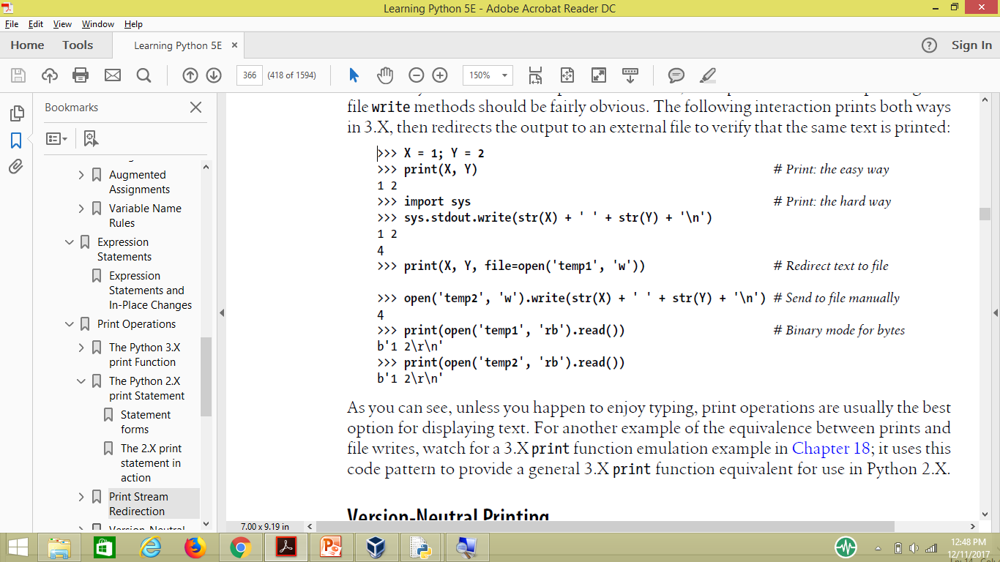

Slide 76
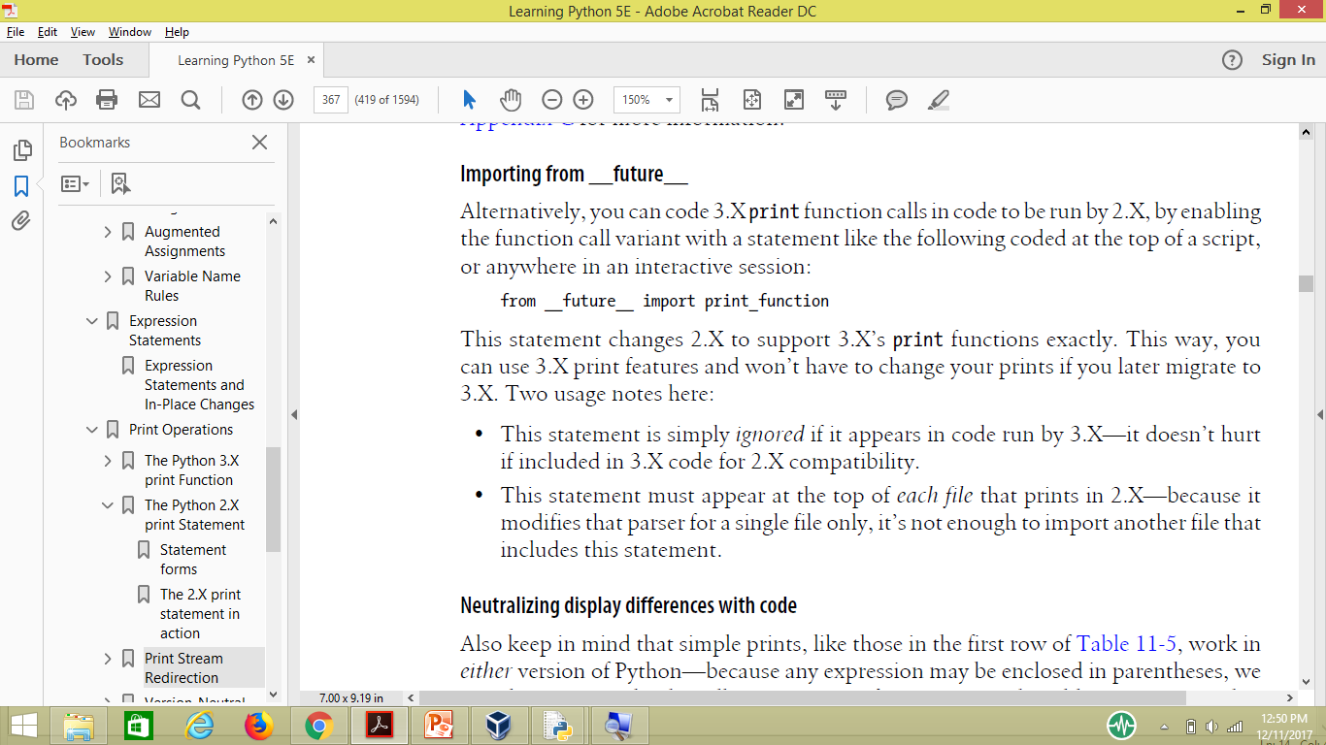
Version-Neutral Printing

